Slide 1
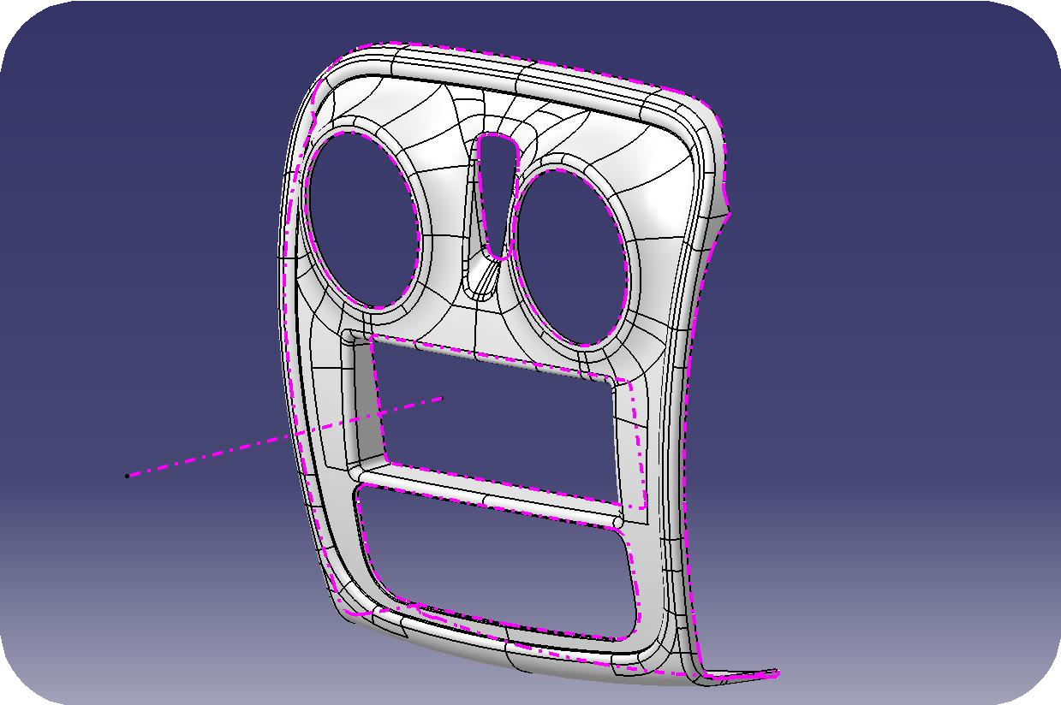
Center Bezel
Automotive Plastic Part Design
BY_DEVANSHU_BORASE

Slide 2
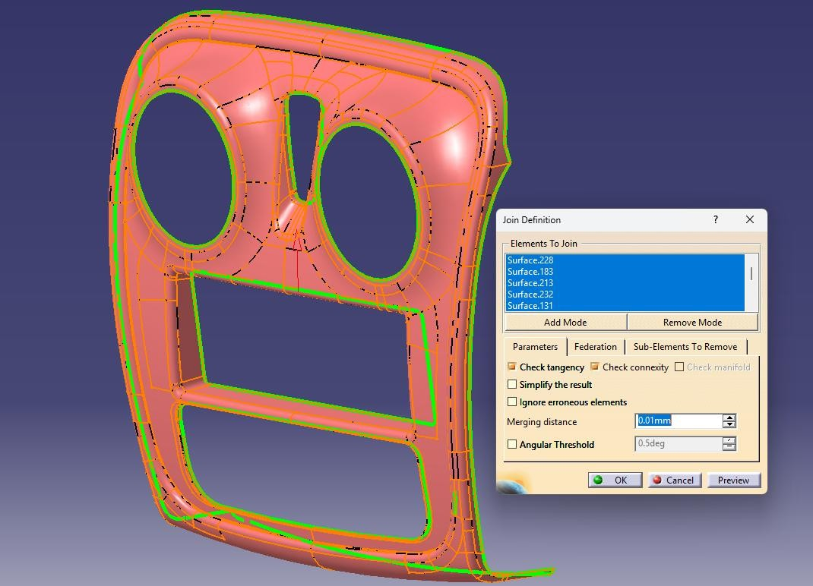
Objective
The objective of this project is to design a center bezel trim component using the provided Class-A surface. The design process involves establishing the appropriate tooling axis, ensuring compliance with draft angle requirements, and finally conducting a draft analysis to validate manufacturability and design integrity.
Class A Surface Analysis
Import the Class A Surface in the software.
Join the imported surfaces with a merging distance of 0.01mm.
Check for any missing surfaces and tangency errors.
In this case all the surfaces are joining at the given merging distance and there are no missing surfaces or any tangency errors.

Slide 3
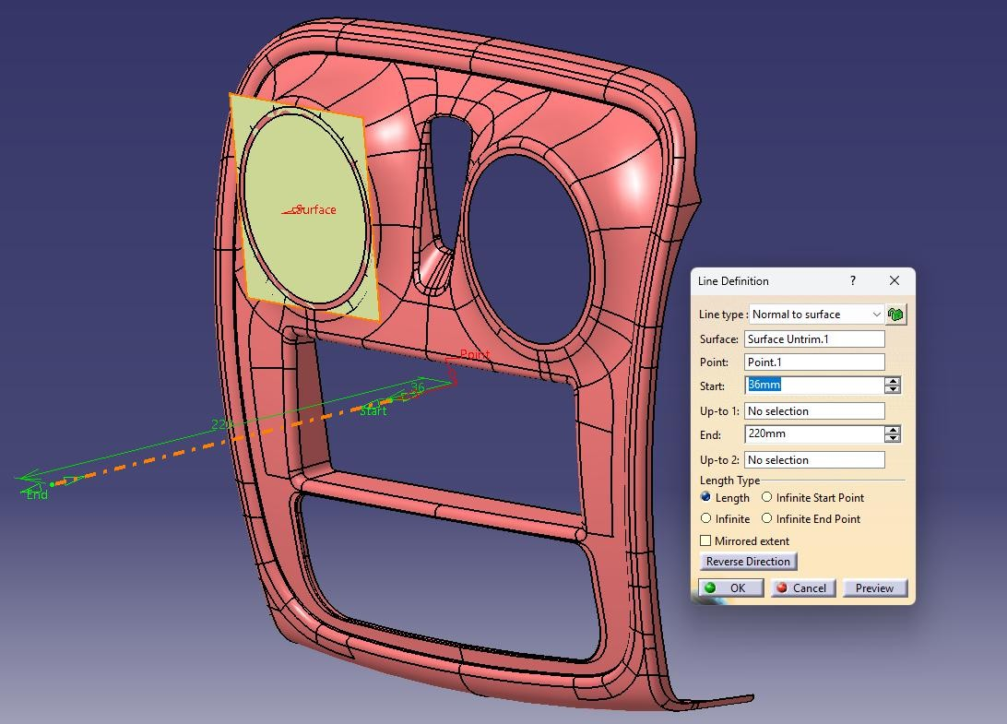
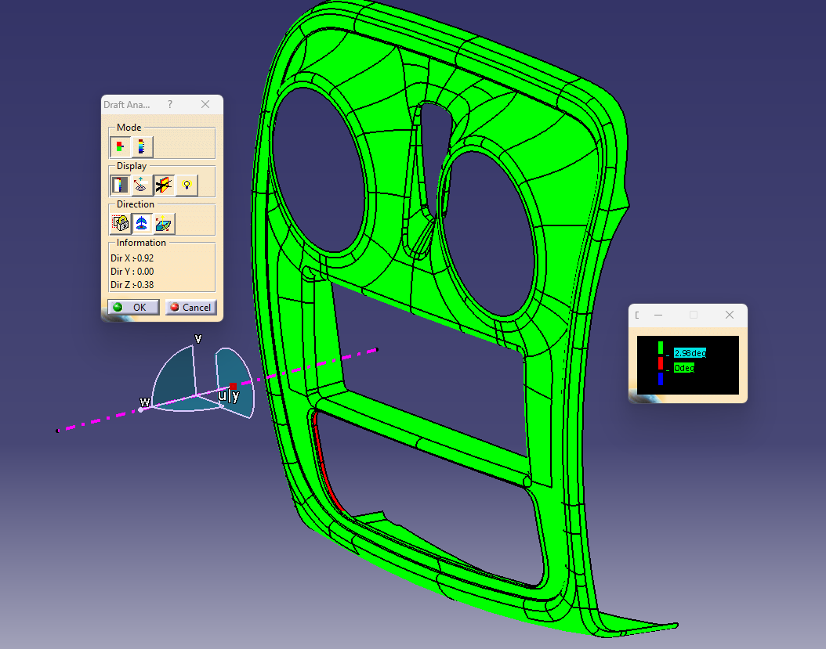
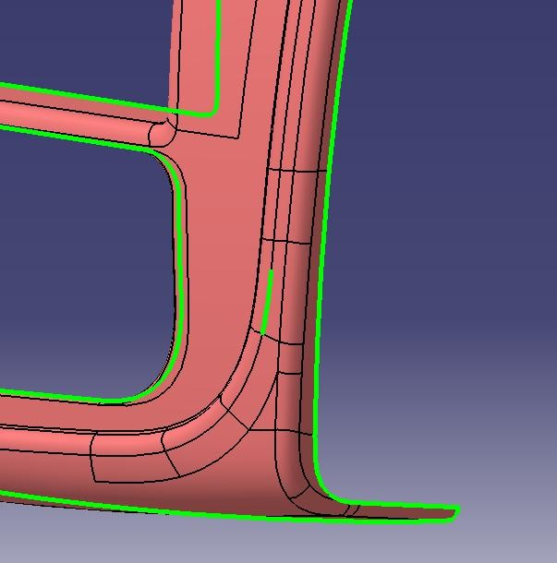
Tooling Axis Creation and Class A Surface Draft Analysis
Tooling Axis Creation
Establish the tooling axis for manufacturability. Analyze the geometry for feasible mold opening direction.
In this case we used normal to surface method for tooling creation.
Apply Draft Angles
Ensure draft angles meet industry standards.
Apply minimum draft angle (commonly 3° for plastics depend on grain pattern can change )
Adjust surfaces to maintain styling intent,
Verify consistency across all faces.
Perform Draft Analysis
Check manufacturability through draft analysis.
Run draft analysis in CAD software.
Highlight positive and negative draft regions.
Confirm all surfaces meet tooling requirements.
Results
Some surfaces are not clearing.
Open Edge
Undercut

Slide 4
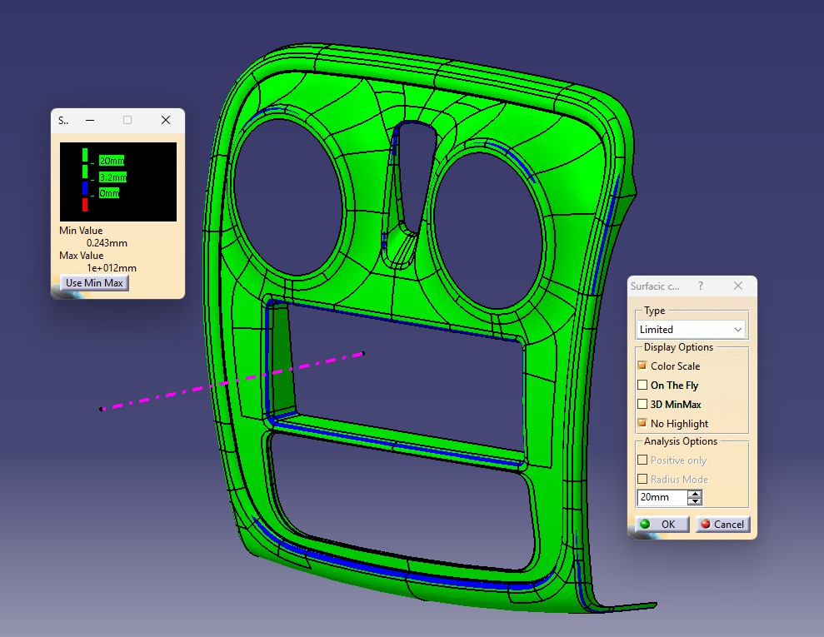
Curvature Analysis
This analysis is to check the minimum radius of a plastic part, if the part clears the minimum radius criteria according to ECE R21 (i.e. 2.5mm).
In this part area highlighted in blue doesn't follow ECE R21.

Slide 5
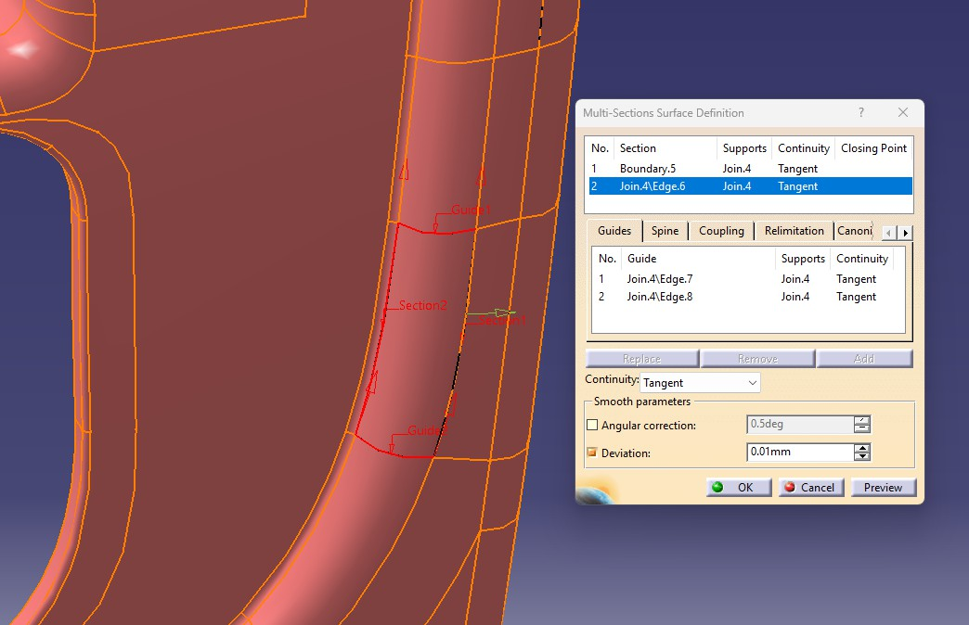
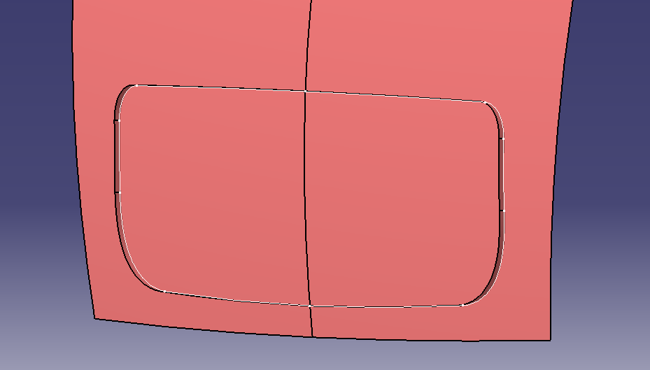
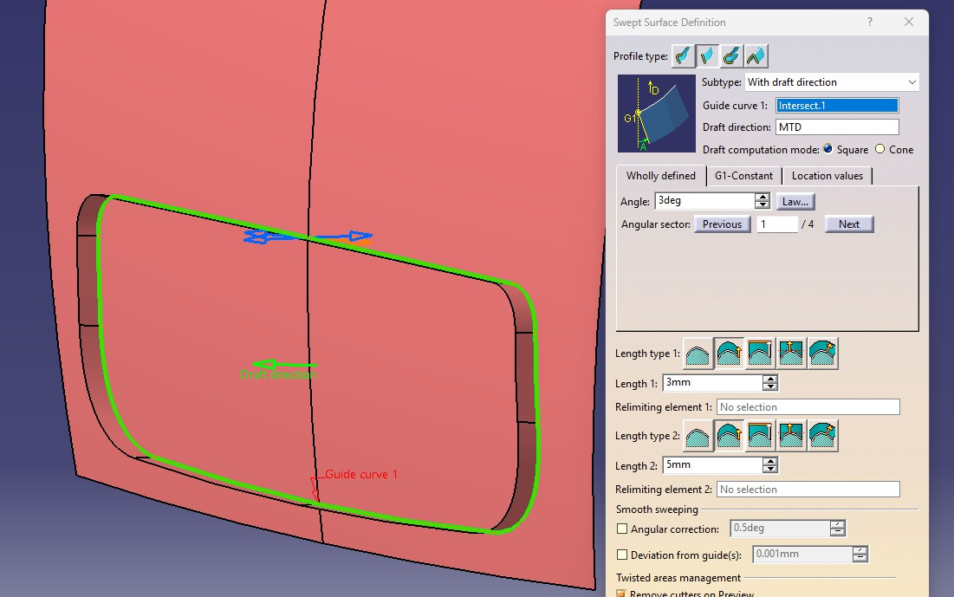
Class A Surface Modification
Remove the open edge by removing the error patch and creating a patch using multis-section.
Area under undercut surface recreation steps: Extract surfaces > Untrim > Join both Surfaces (Left and Right) > Extrapolate the other surface > Create Intersection > Sweep (with draft direction) > Trim > Fillet
Created intersection
Open edge removed
Sweep w.r.t tooling
direction

Slide 6
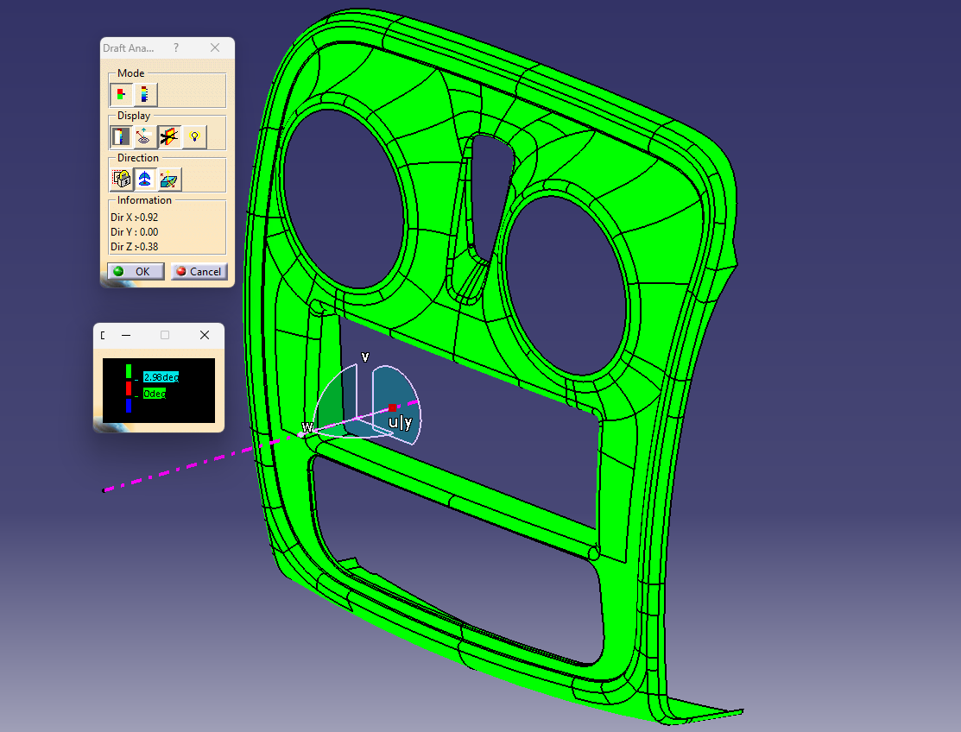
Class A Surface Modification
A-Surface cleared in tooling.

Slide 7
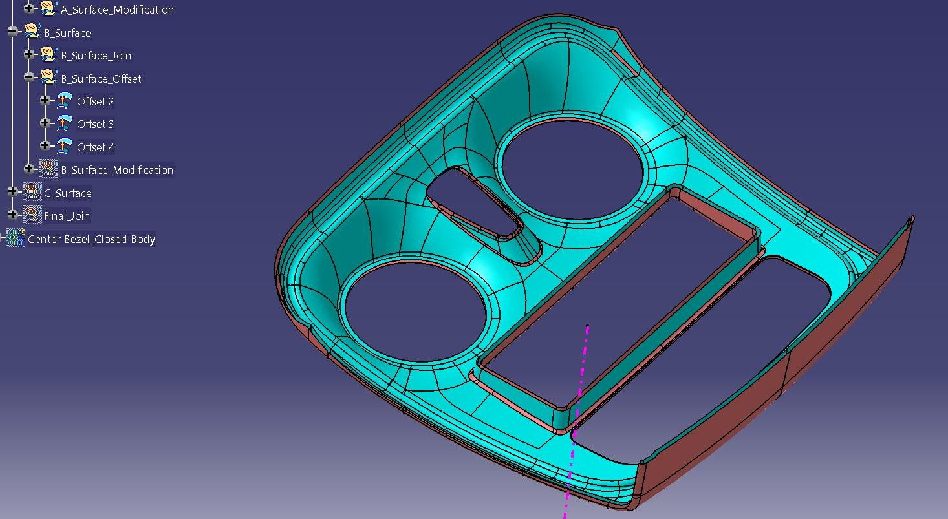
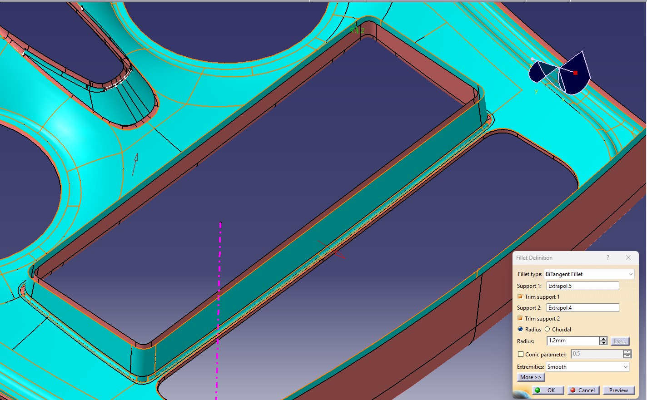
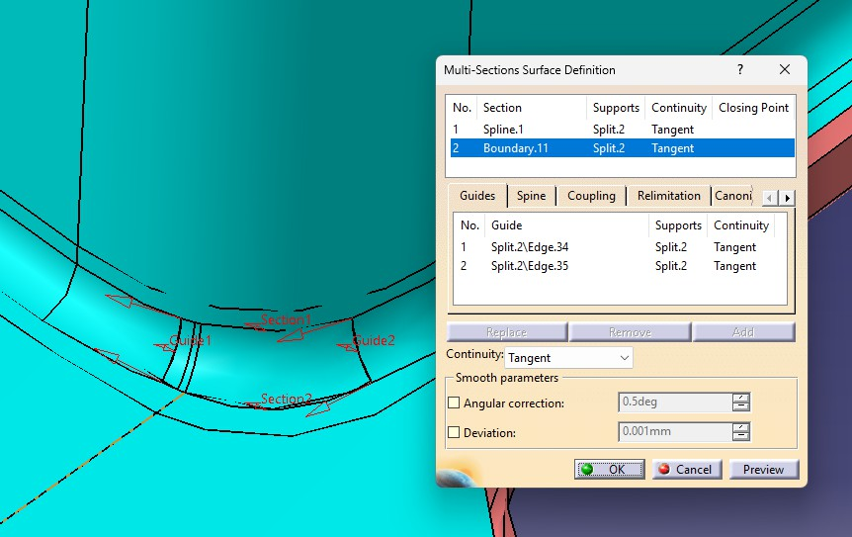
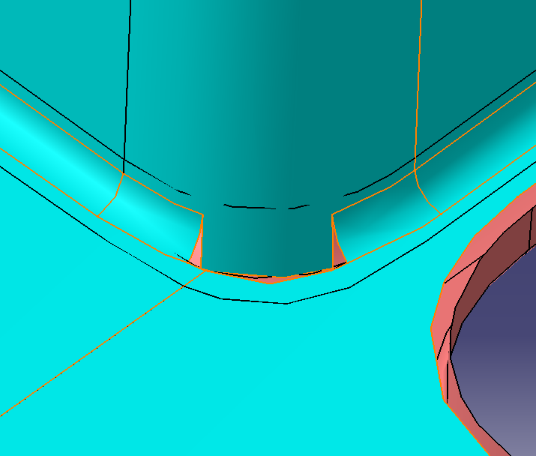
Class B Surface Development
Offset Class A Surface
Create a 2.5 mm offset of the entire Class A surface to define the base thickness.
Note: Complex regions may fail to offset correctly, especially filleted areas.
Identify Missing/Failed Regions
CATIA highlights sub-elements (fillets, patches) that cannot be offset.
These must be reconstructed manually.
Manual patch creation
Used extrapolate and surface fillet command.
Used split > multi-section where fillet did not come.
3 different offset
Join Surfaces
Apply the Join command to merge the offset patches with the primary offset
surface.
Verify connectivity using the Boundary command to ensure no gaps remain.
surfaces

Slide 8
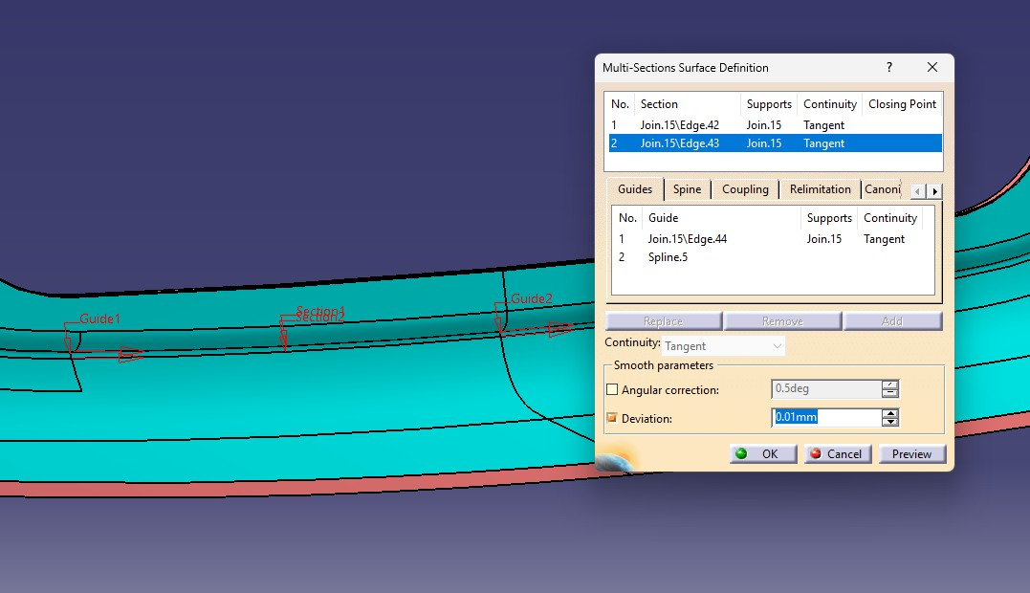
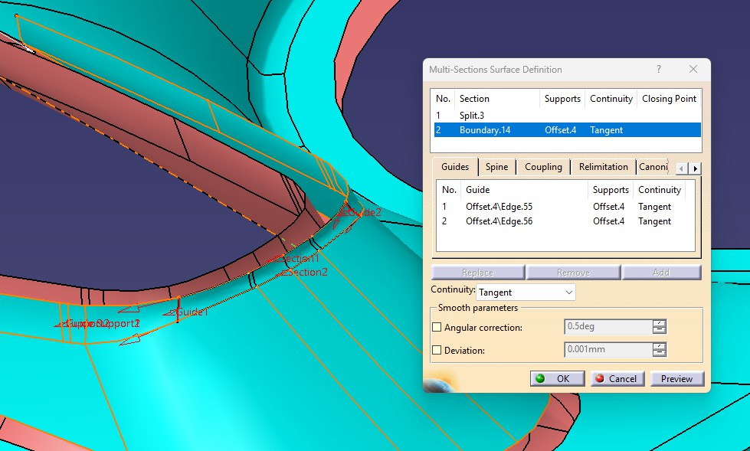
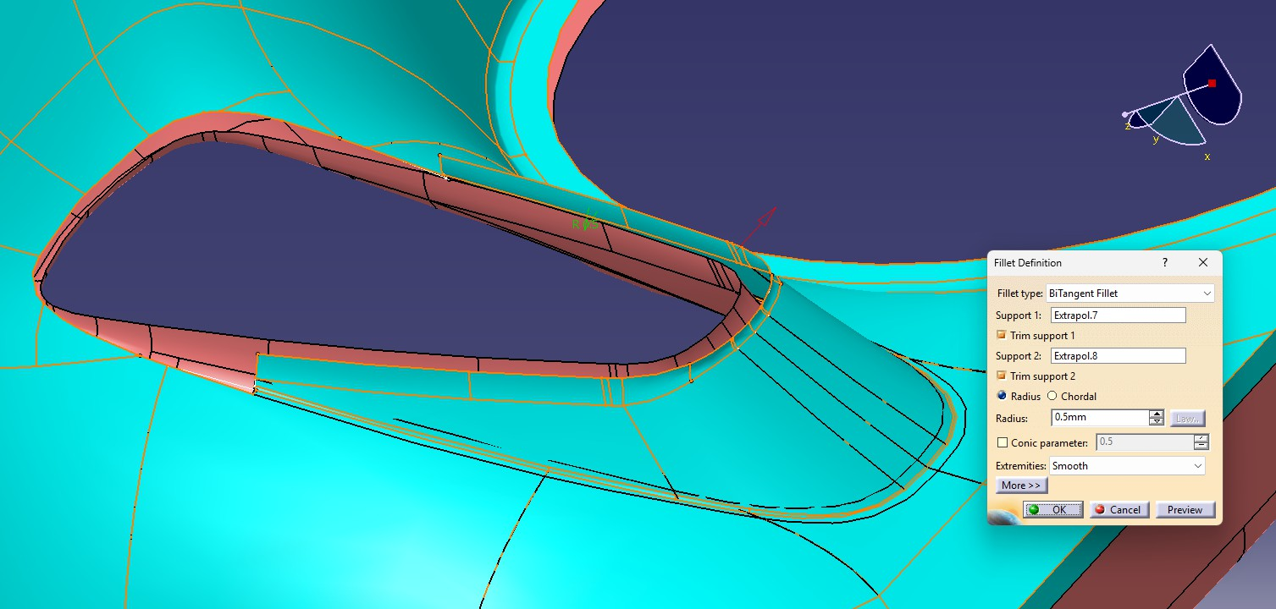
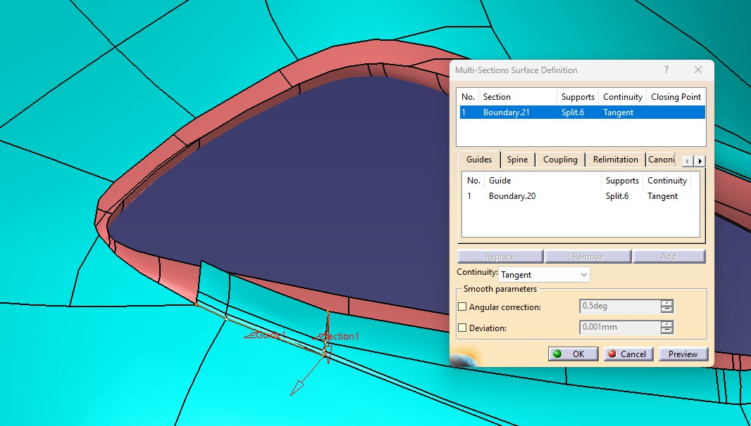
Class B Surface Development
Multi-section (Patch creation)
Multi-section (Patch creation)
Shape Fillet
Multi-section

Slide 9
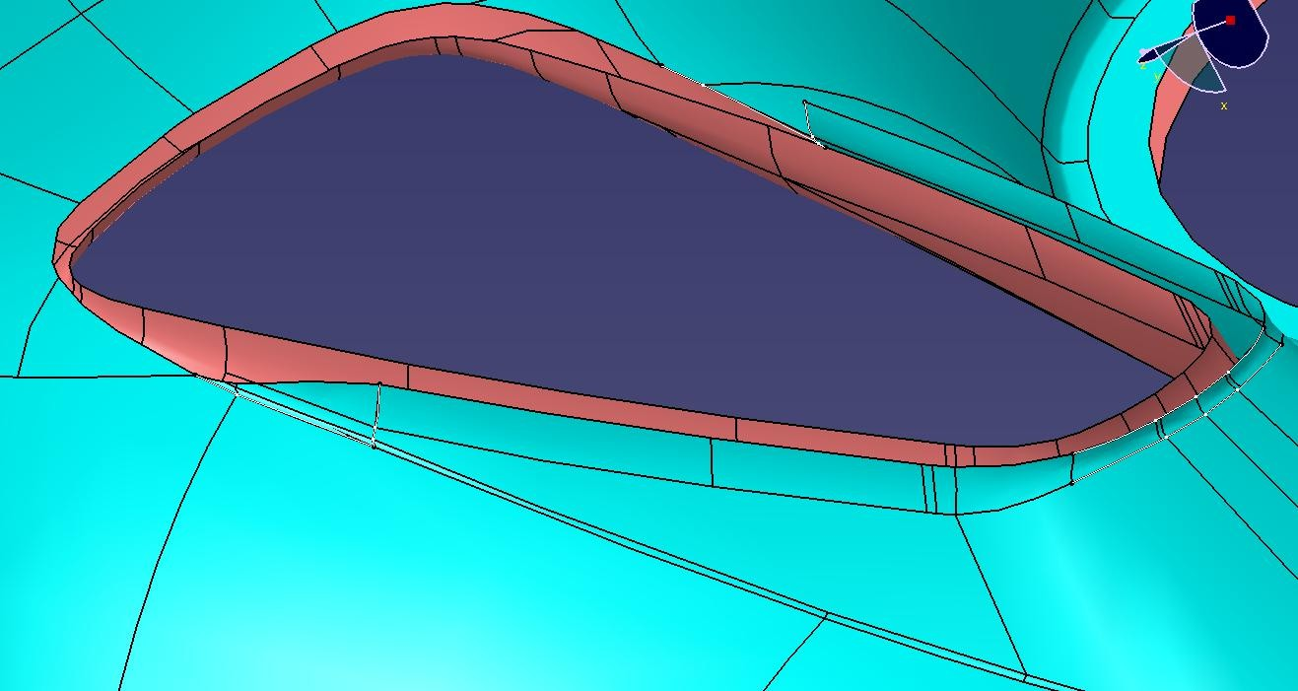
Class B Surface Development
Split

Slide 10
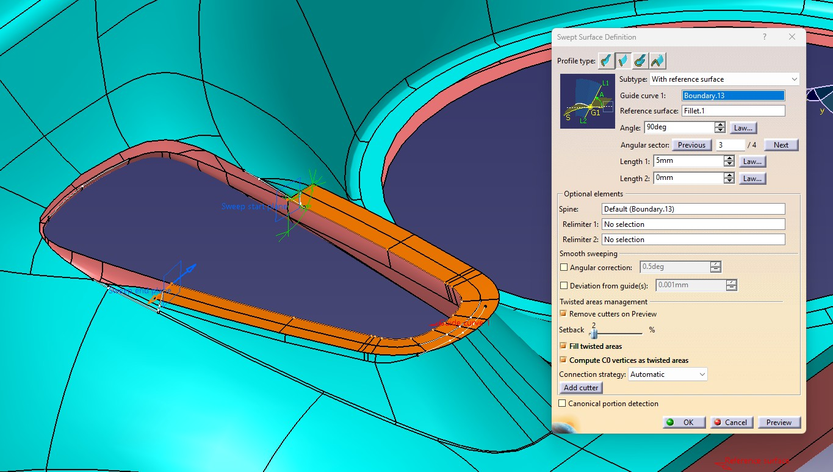
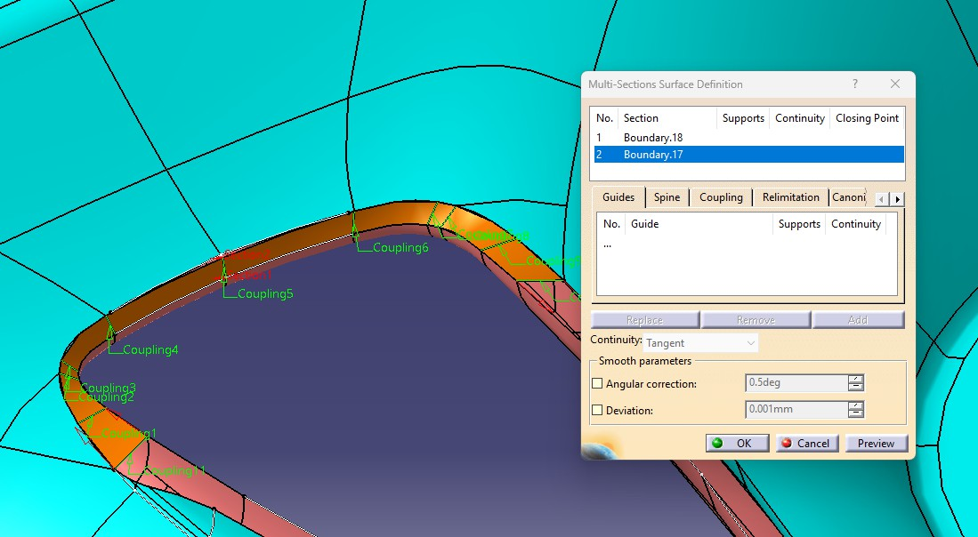
Class C Surface Development
Identify Boundary of Class A Surface
Extract the boundary edges of the Class A surface.
These edges will serve as the reference for creating the Class C surface.
Define Tooling Axis
Establish the tooling axis based on the draft requirements.
This ensures that the Class C surface will be manufacturable with proper draft
angles.
Sweep Operation
Use the Sweep command along the tooling axis to generate Class C surfaces from the extracted boundaries.
Apply the required draft angle (0.5° specified for class C surface to clear in core side) during the sweep.
Check Continuity
Verify that the swept Class C surfaces connect smoothly with the Class A and Class B surfaces.
Adjust sweep parameters or extend boundaries if gaps are detected.
Join Surfaces
Merge the Class C surfaces with Class A and Class B using the Join command.
Ensure the joined body forms a closed surface without openings.

Slide 11
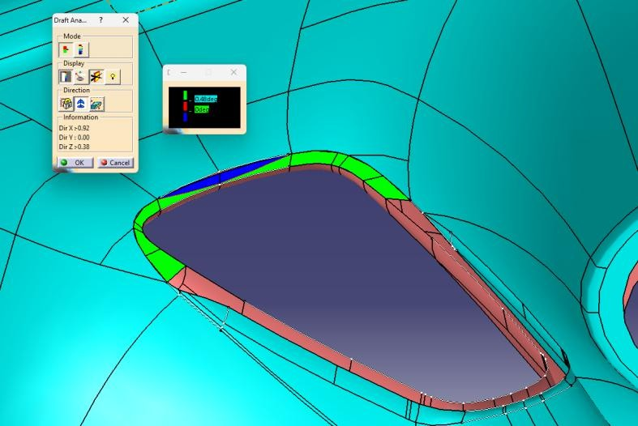
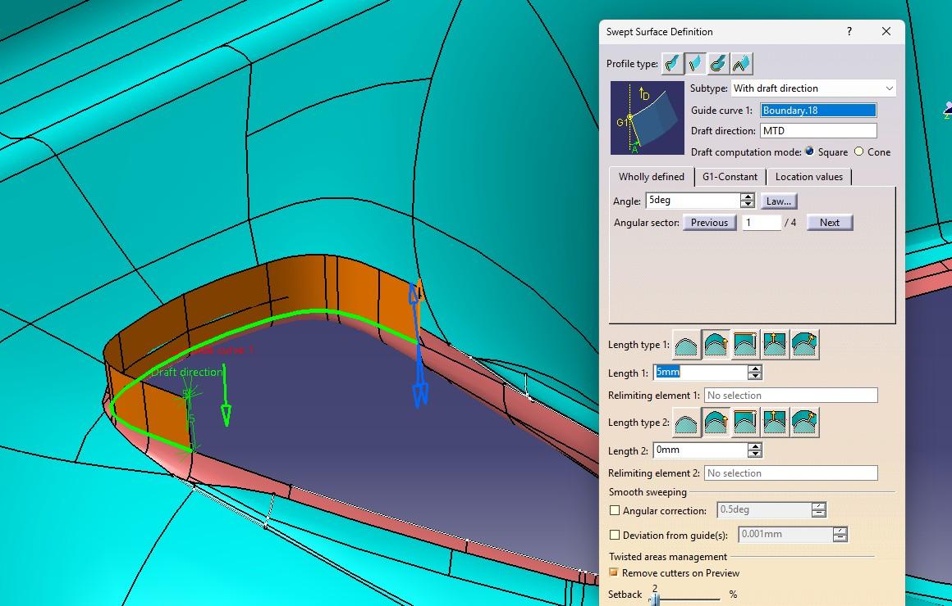
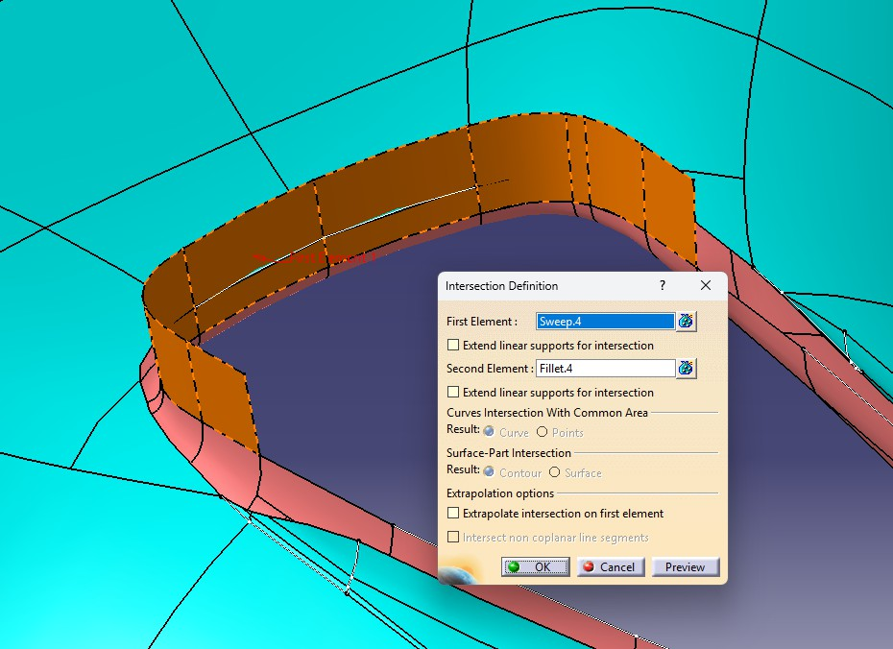
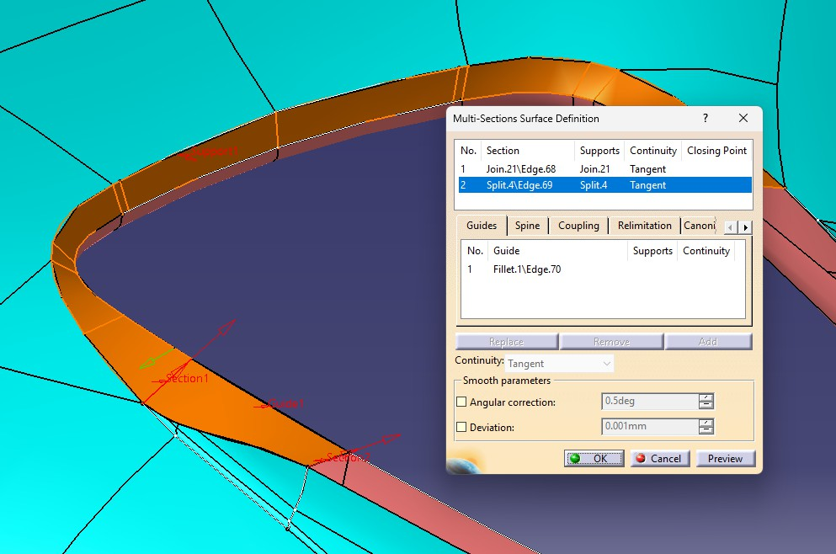
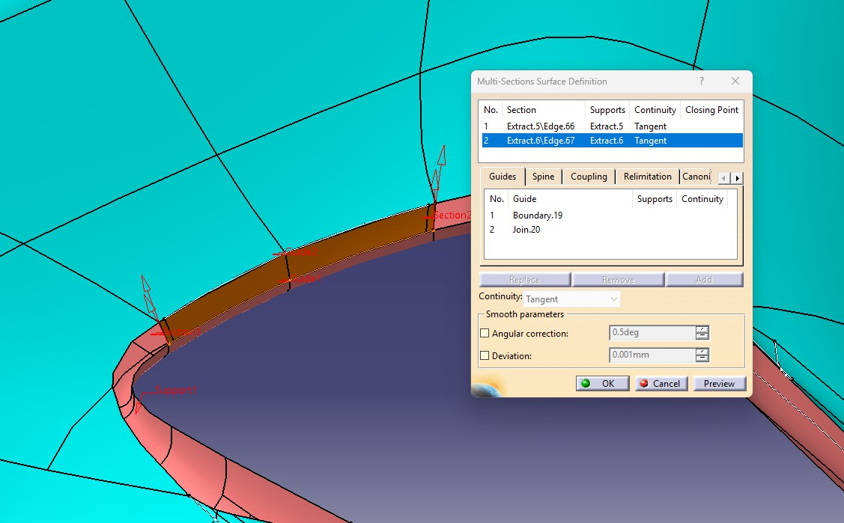
Class C Surface Development
Undercut in core side >
Sweep
Create Intersection > Split B-Surface
Remove the undercut
patch and recreate
Multi-section
Multi-section

Slide 12
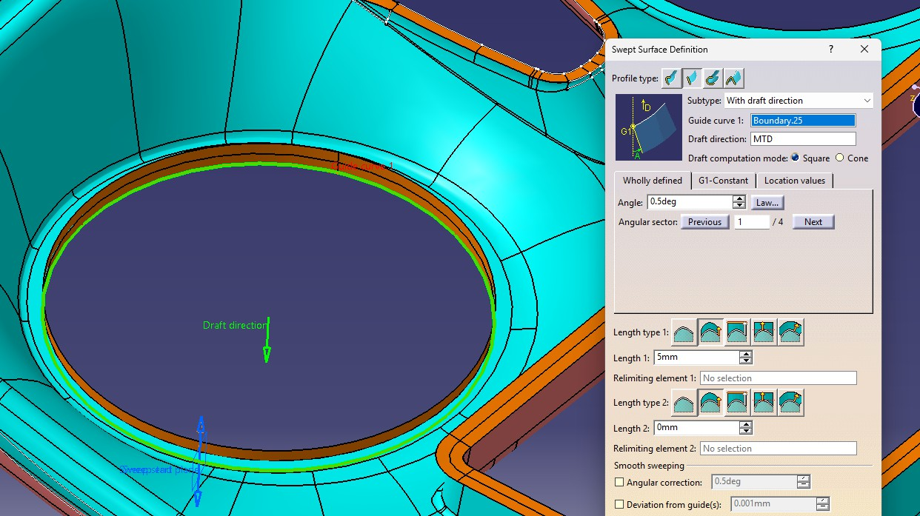
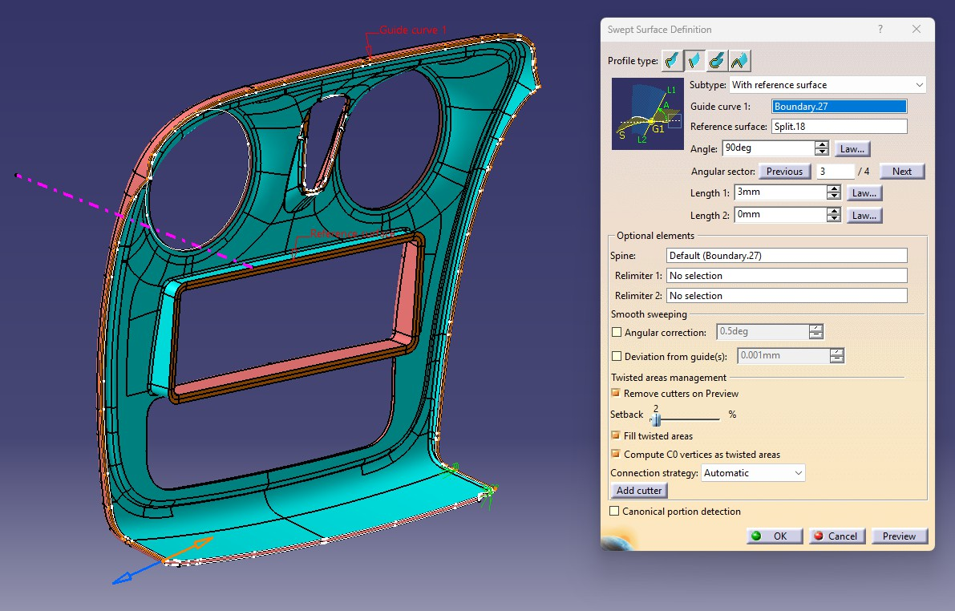
Class C Surface Development

Slide 13
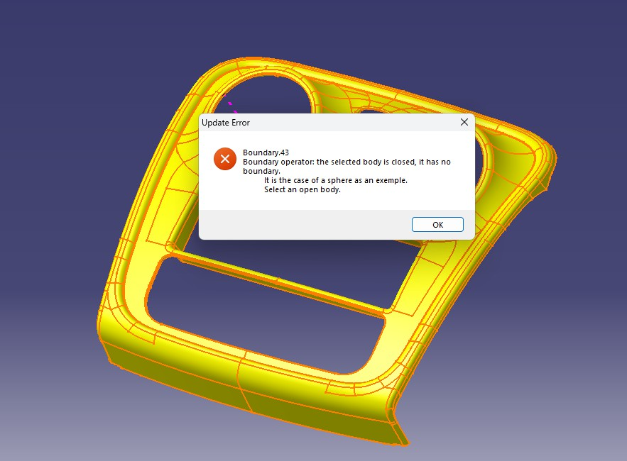
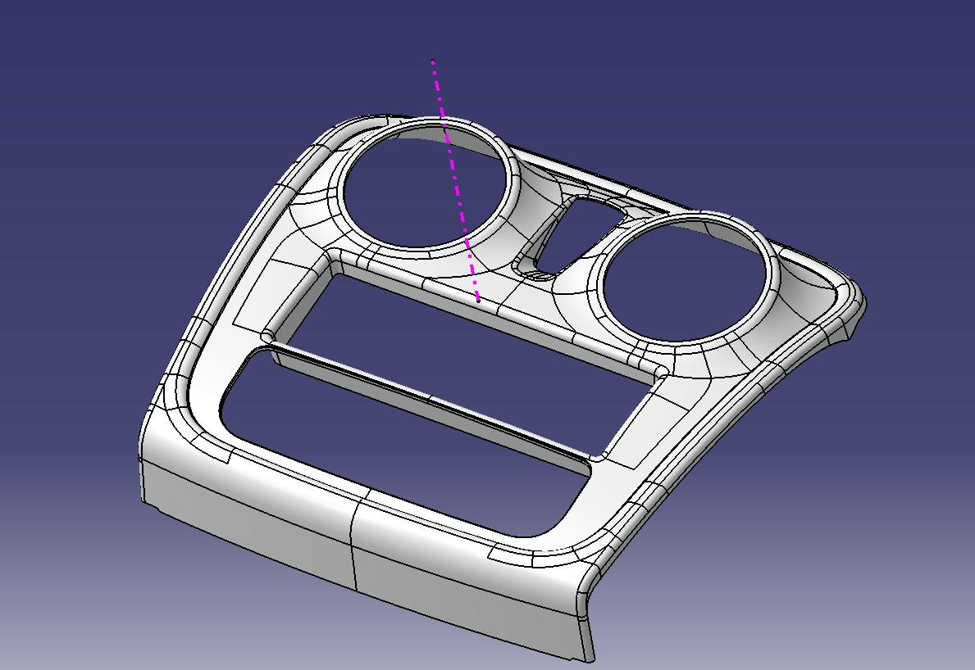
Final Trim and Solid Part Conversion
Final Trim
Perform a Trim operation to cut and align Class A, B, and C surfaces together.
This step creates a single, continuous closed surface model.
Solid Conversion
Once the closed surface is validated, convert it into a solid body using the Close Surface command.
This completes the center bezel as a solid part ready for draft analysis and further validation.

Slide 14
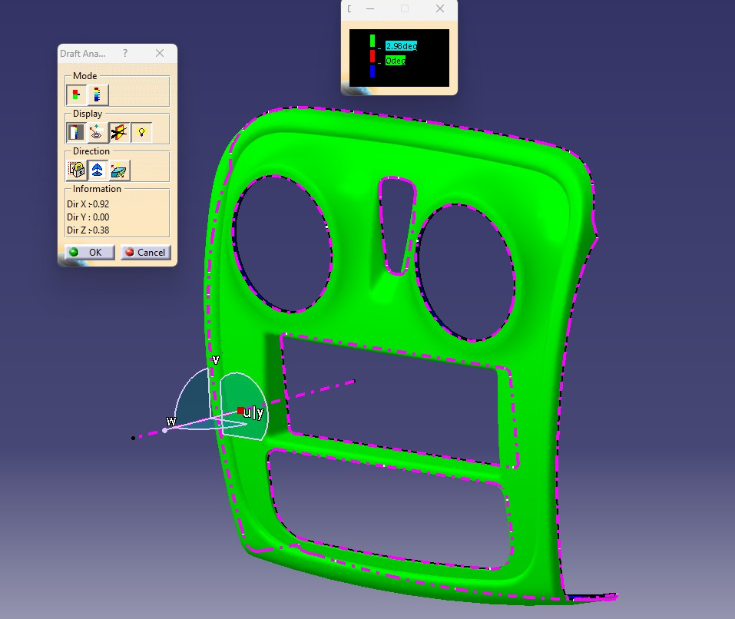
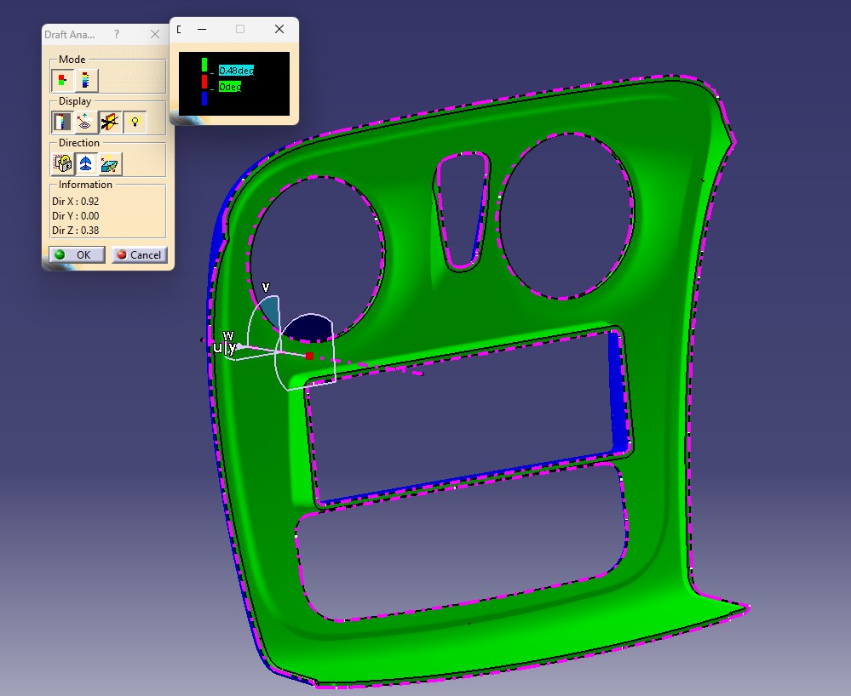
Draft analysis on solid part for parting line creation
Draft Analysis was performed on the center bezel using the defined tooling axis. The analysis confirmed that most surfaces meet the required 3° draft angle, ensuring manufacturability also extracted parting line. Color coding highlighted acceptable regions in green, with minor adjustments needed in red/blue areas. Overall, the design is validated for production feasibility.
Cavity
Core

Slide 15

Center Bezel
Hence, the center bezel component was successfully designed and developed, incorporating Class A, B, and C surfaces, tooling axis, draft angle requirements, and validated through draft analysis to ensure manufacturability and finally finalized parting line.

